Slide 1
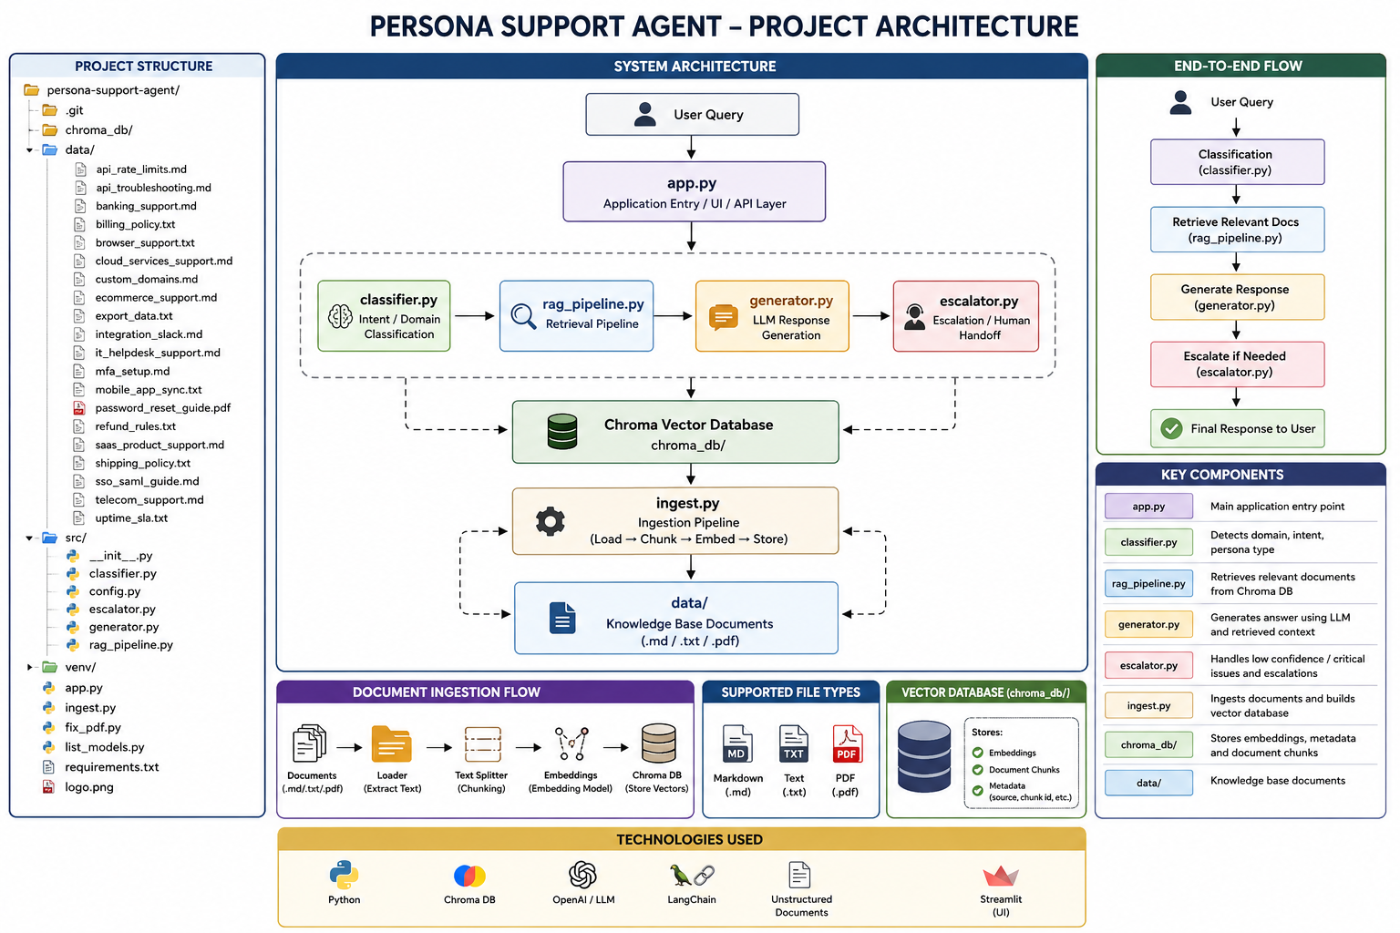
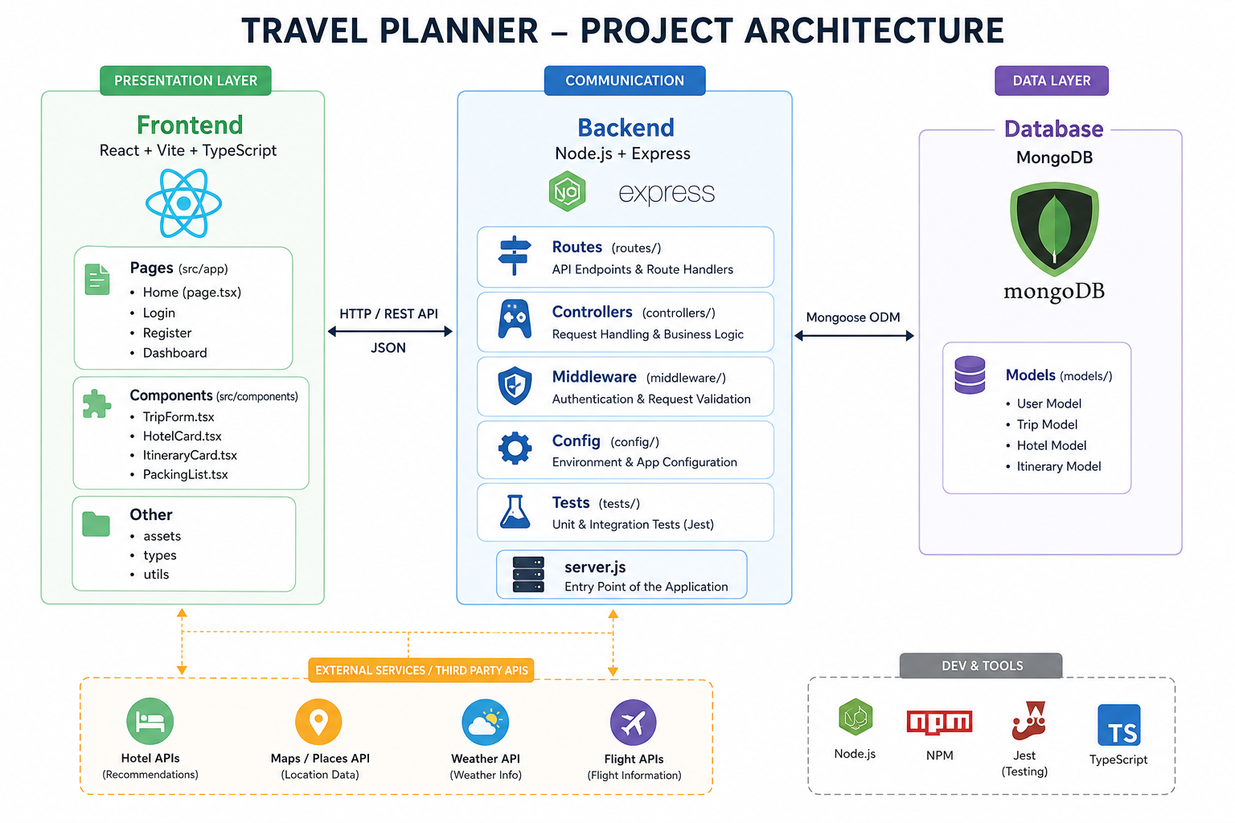

Slide 2
Technologs:
Backend: Node.js, Express, MongoDB, React,vite, TypeScript Frontend:
React + Vite + TypeScript
Pages: Login, Register, Dashboard
Components: TripForm, HotelCard

Slide 3
Unit Testing:
api.test.js Route level test
Spins up a real Express app
Tests POST /api/auth/login with wrong credentials
Expects a 401 status and "Invalid email or password" message
Mocks User.findOne to return null so it never hits the real database
auth.test.js Controller unit test
Tests registerUser controller directly, without HTTP
Mocks User.findOne to return an existing user
Expects a 400 status and "User already exists" message
trip.test.js The most detailed test file
Tests generateNewTrip controller
Three test cases:
Missing destination → expects 400
Successful AI response → mocks fetch and Trip.save, expects 201
Gemini rate limit (429) → mocks setTimeout to skip backoff delay, expects 500

Slide 4
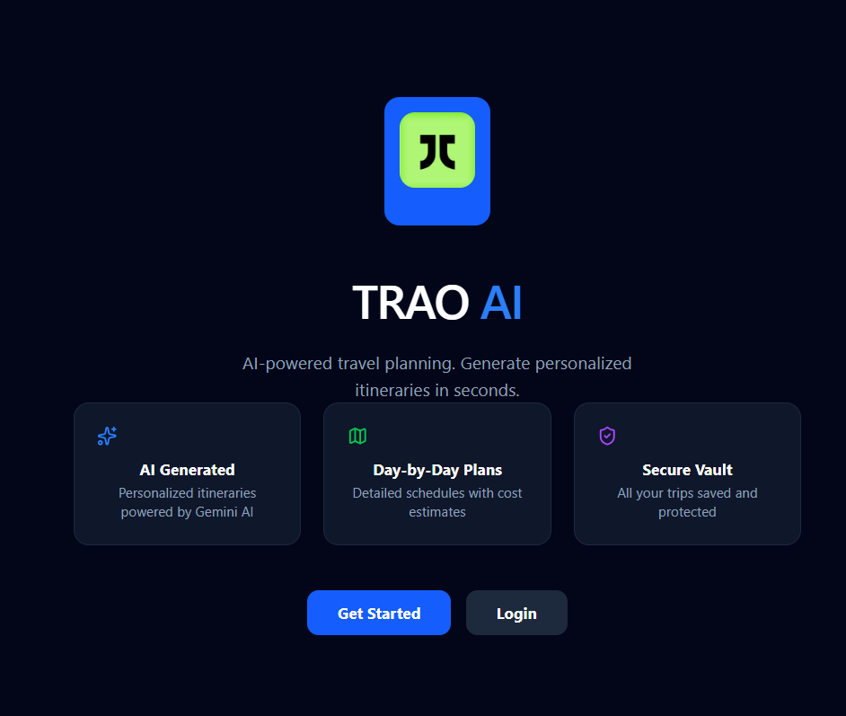
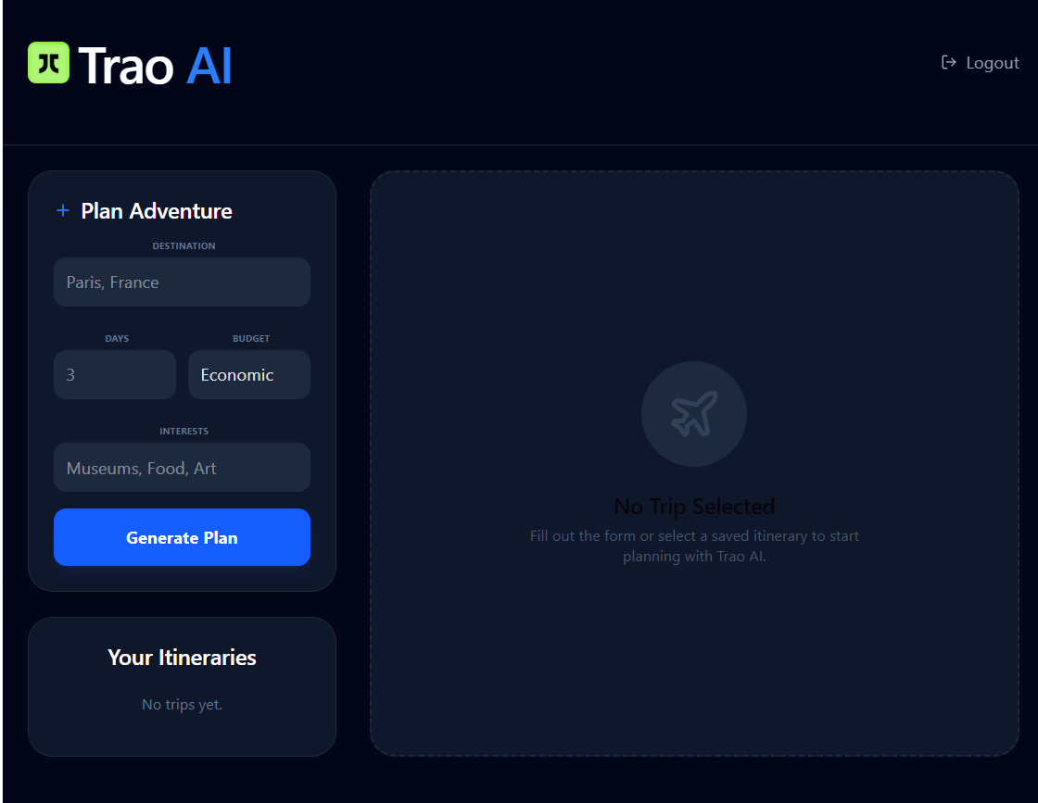
Home Dashboard

Slide 5
When the user is logged in, they land on the dashboard. The left column has the trip planning form with four inputs:
Destination: e.g. "Tokyo, Japan"
Days :min 1, max 10
Budget — a dropdown: Economic / Standard / Luxury (maps to Low / Medium / High in the backend)
Interests e.g. "Food, Anime, Temples"
Backend : the request hits POST /api/trips, passes through the auth middleware which verifies the JWT, then reaches generateNewTrip() in tripController.js.
The controller builds a detailed prompt and sends it to the Gemini AI API. The prompt asks Gemini to return a strict JSON object containing:
Day-by-day itinerary with activities
Hotel suggestions with ratings and amenities
Estimated budget breakdown
Weather-aware packing list

Slide 6
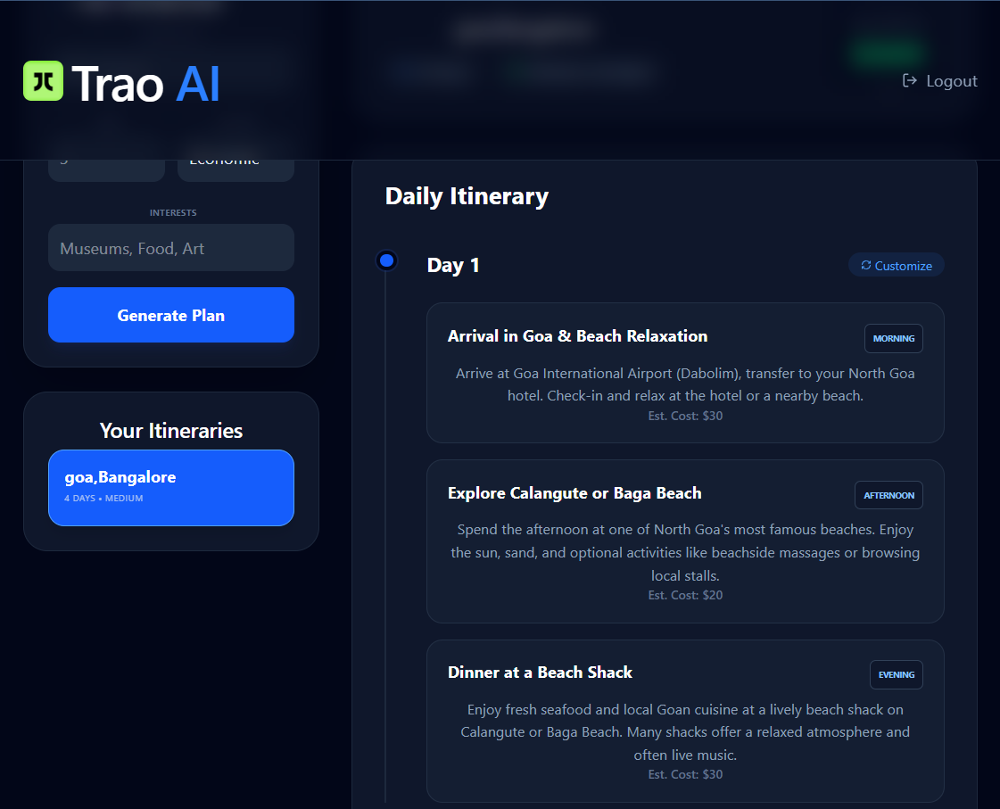
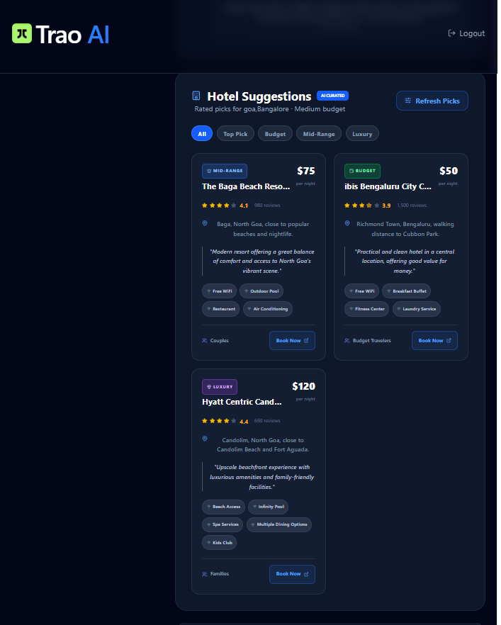
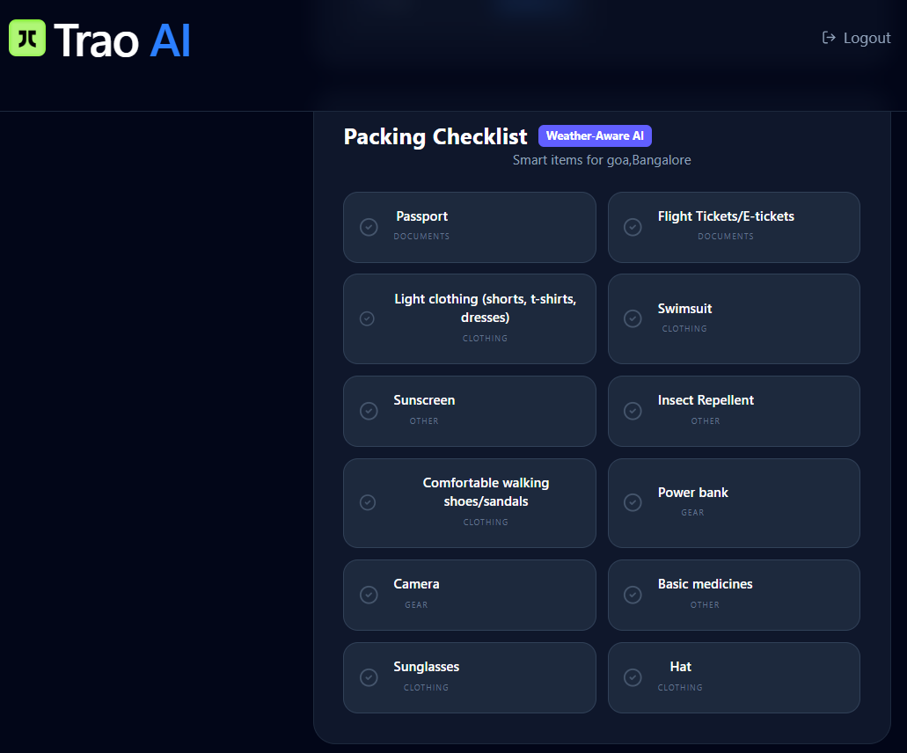

Slide 7
Thank you

